Slide 1
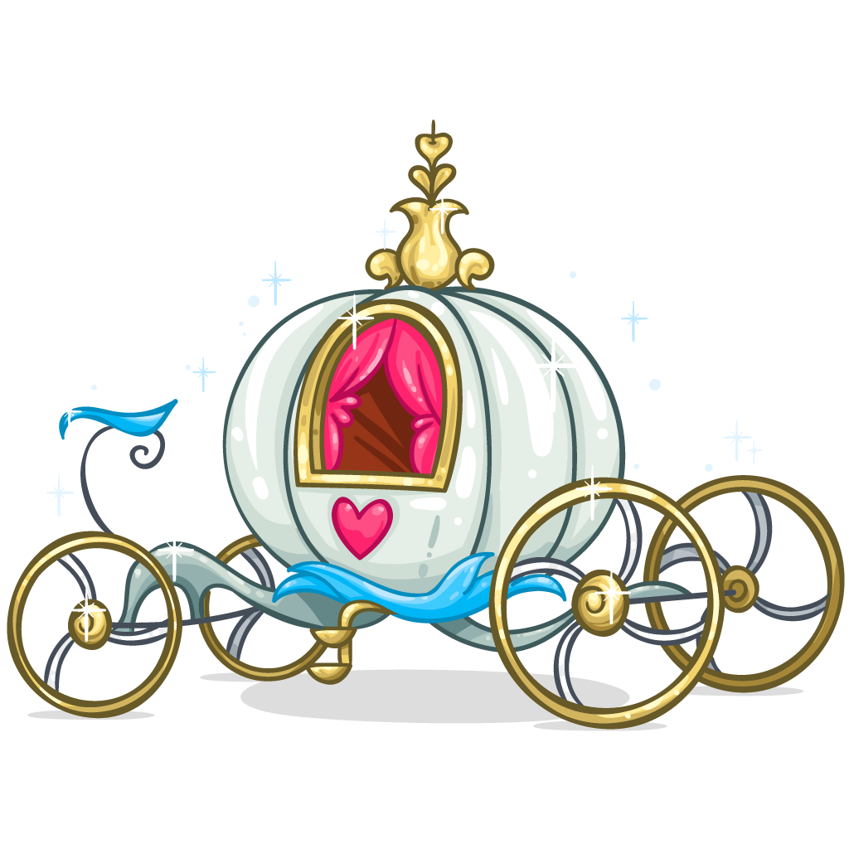
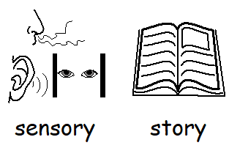

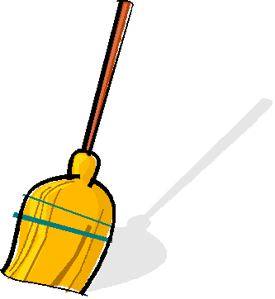
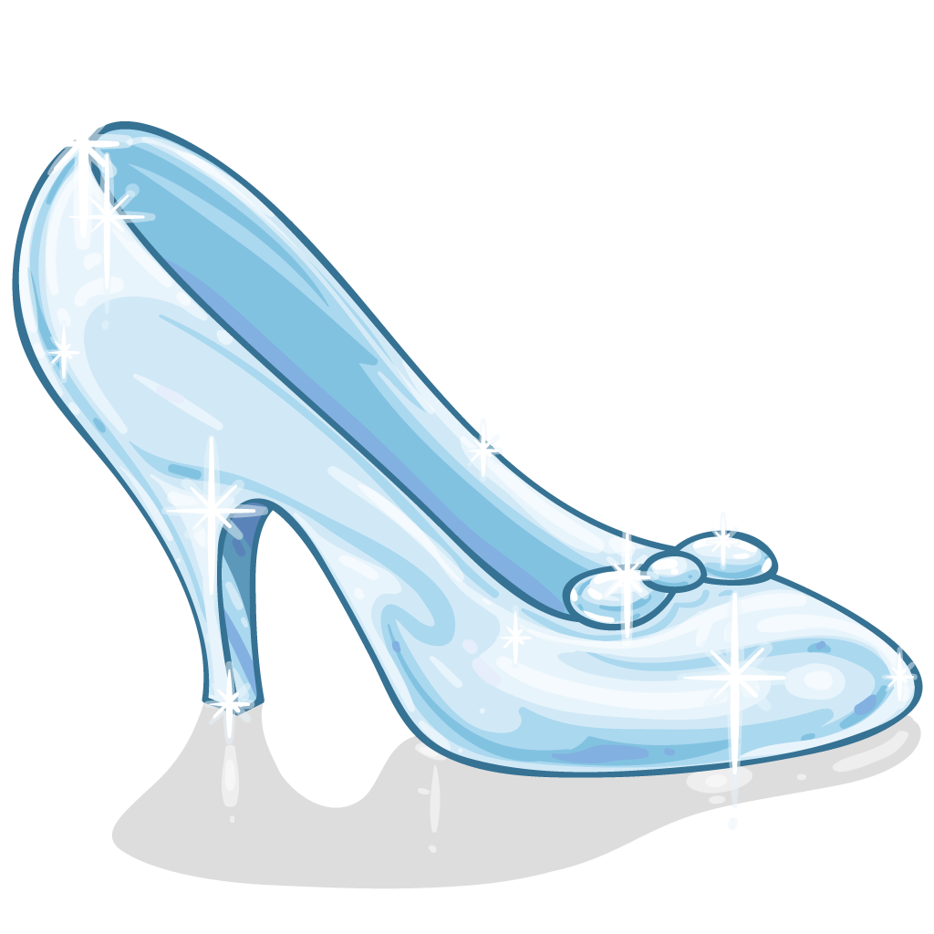
Cinderella
A sensory
story

Slide 2


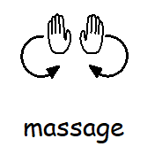
How to use this story
Each part of the story comes with a suggested activity which can be completed independently or with support.
Encourage the listener to use their senses to bring the story to life and communicate likes and dislikes.
The story can also be used alongside a set of massage strokes given next to each verse.
Story massage can be used to improve calmness and concentration.

Slide 3
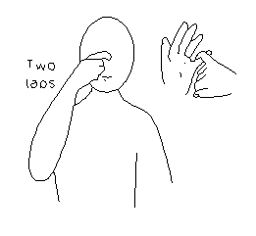
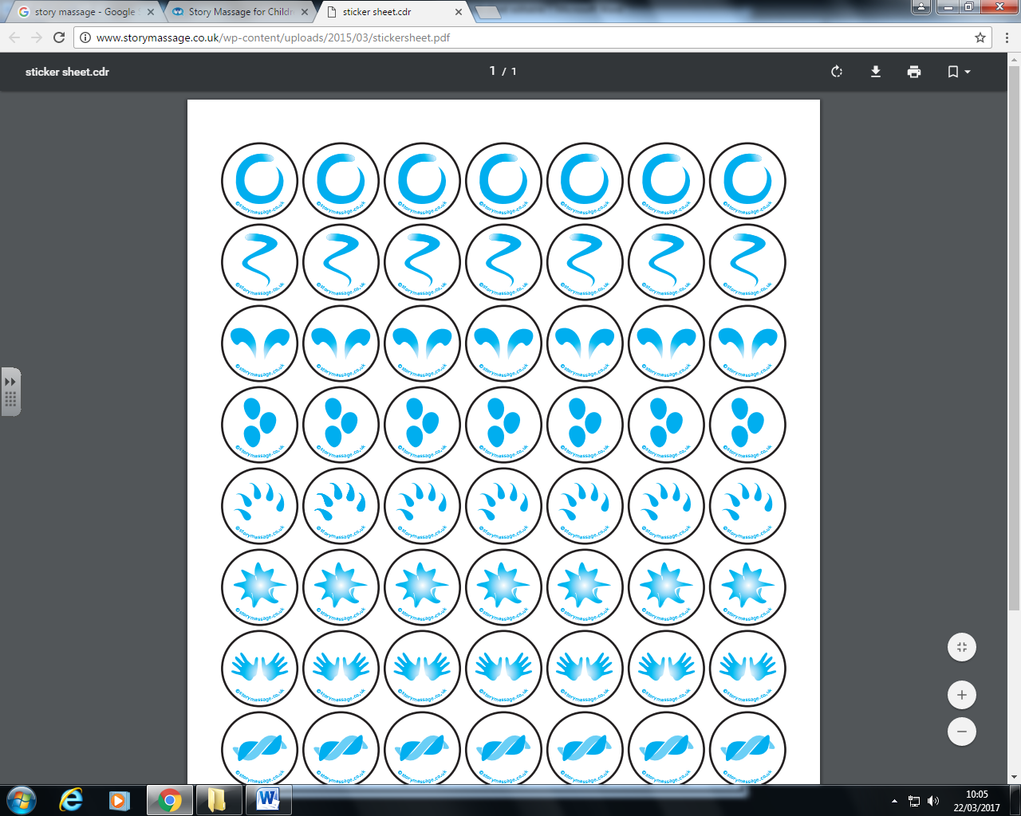
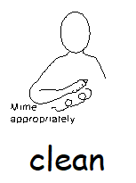
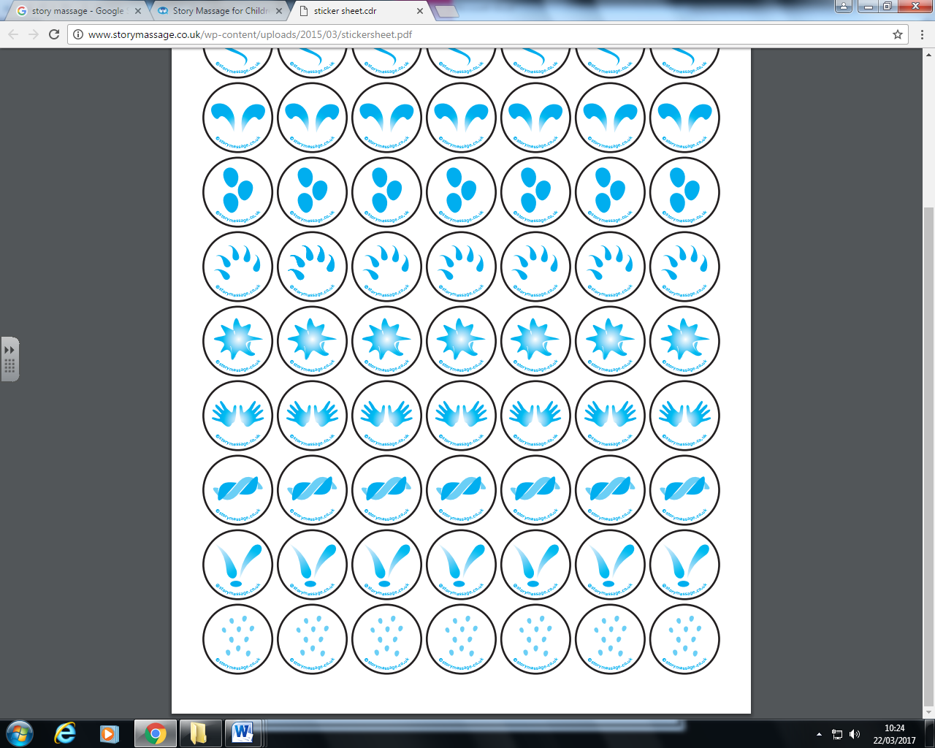
Story Verse | Activity | Massage Stroke | Signs
Once upon a time a little girl called Cinderella lived with her step mother and two ugly stepsisters, Doris and Delilah. | Reader to make funny voices to imitate the sisters. Leave a pause after each sentence, word or vocalisation to allow a chance for vocal turn taking. | The fan With both palms flat, start with hands at the centre together and move up and out (away from each other) to create a fan shape
Cinderella was very unhappy because she had to do all the work in the house. She did all the washing, cleaning, scrubbing, polishing and vacuuming. | Explore bubbles in a washing up bowl and different cloths, brushes and sponges. Listen to sound of the vacuum – press to turn it on. Could you help with any household chores? | The squeeze Use both hands (between fingers and thumb) to gently ‘squeeze’ the area and hold.
sisters

Slide 4
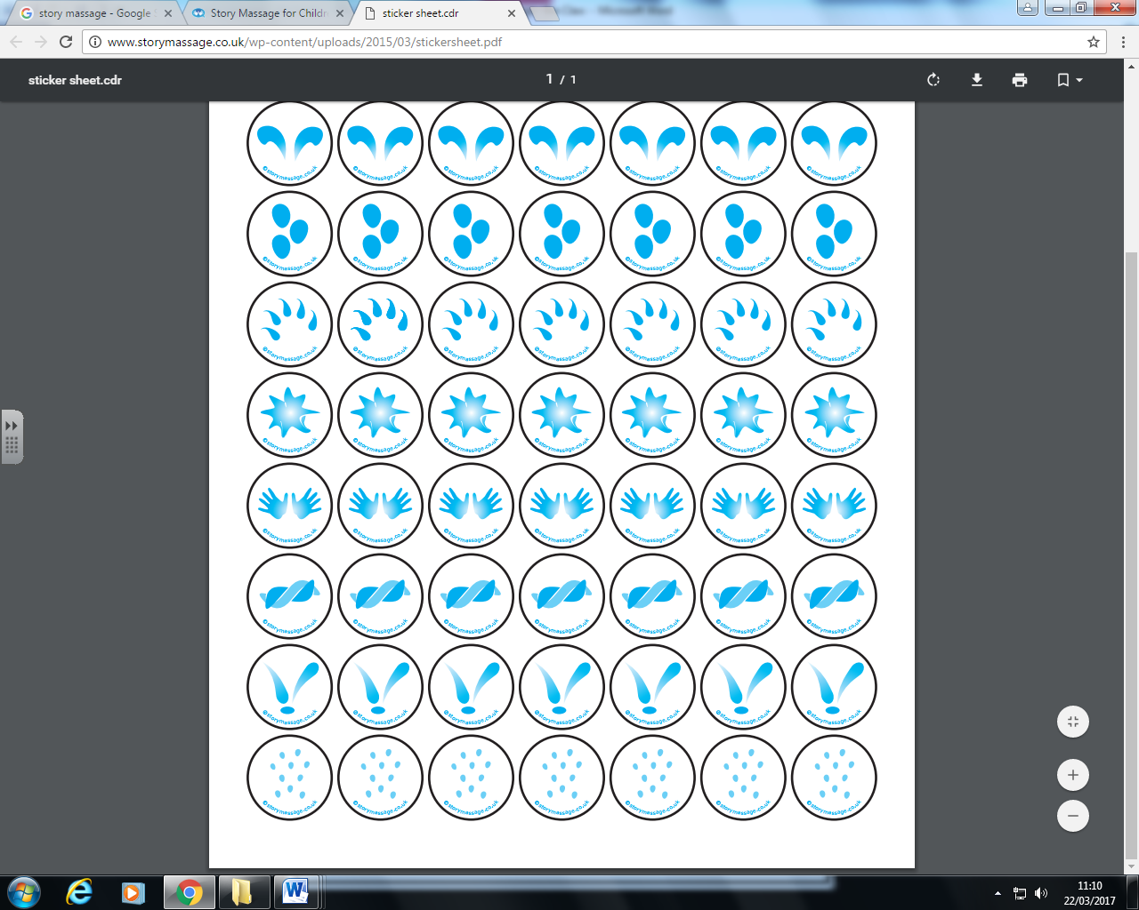


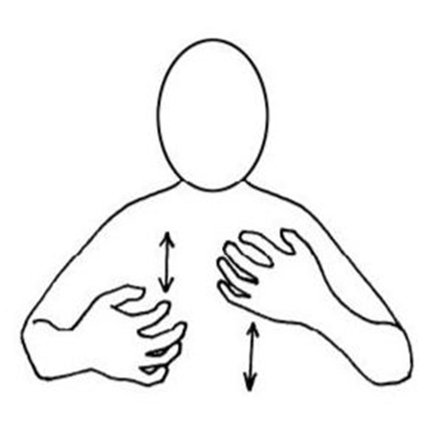
Story Verse | Activity | Massage Stroke | Signs
One day a special letter arrived in the post. It was an invitation to a ball at the royal palace. | Have a selection of papers, envelopes or wallets. Practise putting the paper in the envelope or opening it – pulling and grasping. Using a box with a hole cut out, try posting objects into the box. | The drum Hands make a fist and gently knead.
Cinderella wondered if she would be able to go to the ball but Doris and Delilah just laughed at her and told her to get on with her work. Cinderella watched as Doris and Delilah got ready for the ball. They were very excited. | Smell different perfumes or aftershaves. Feel creams or shaving foam on your hands and/or face. Do you like it? Have a go at styling your hair or trying on fancy clothes – How do they feel, what do they look like in the mirror? | The circle With your palm flat, make a circle
exciting

Slide 5

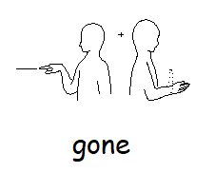
Story Verse | Activity | Massage Stroke | Signs
The ugly sisters and the stepmother went off to the ball and Cinderella was left alone crying by the fire. Suddenly there was a twinkling sound and a fairy appeared “I am your fairy godmother” said the fairy “Why are you crying?” “Everyone has gone to the ball and left me alone” said Cinderella. | Feel droplets of water fall on your cheeks and the warmth of a heat pack. Light some LED candles or turn on some fairy/sensory lights – Can you track them left to right or up and down? Listen to the sound of bells or a twinkly ringtone. Can you turn towards the sound? | The sprinkle Use your fingertips alternately to tap over area like rain.
“Dry your eyes my dear, you shall go to the ball” said the fairy She waved her magic wand and Cinderella was suddenly wearing a beautiful dress “Off you go, but you must be back before midnight” and in a flash, she was gone. | Grasp a baton or ‘wand’ – (you could make a wand by wrapping a pencil in paper and decorating it!) Can you wave your wand up and down and side to side? You or the reader hide behind your hands or fabric – can you find them? | The wave With your palm flat, draw a vertical wavy line

Slide 6
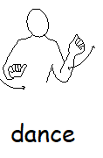
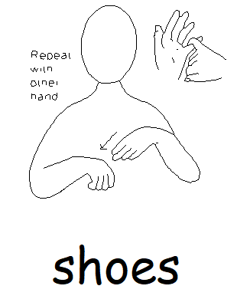
Story Verse | Activity | Massage Stroke | Signs
Cinderella danced with the prince all night and he fell in love with her. Soon it was nearly midnight. | Using YouTube, play a variety of different dance music. If students are in a chair, experience swirling around. If students are lying down use fabrics to swirl to the music. If you have some, light sensory lights – observe tracking. Finally, use Woodblocks, sticks or cutlery to make ticking sounds leading to twelve strokes on bell for midnight. | The bounce Use one hand at a time to gently ‘squeeze’ and pick up the area and then release upwards.
Cinderella dropped her shoes and ran home just before her beautiful dress disappeared. The next day the prince came to the house looking for the girl who could fit into the shoes that had been dropped. | Spend time trying on different shoes. Try on different sizes belonging to people in the household. Can you recognise your own shoes? | The walk Palms flat, place one after each other and ‘walk’ up or down the area

Slide 7
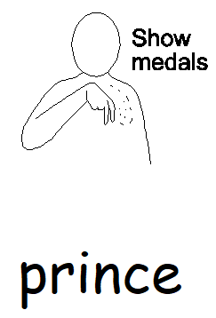


Story Verse | Activity | Massage Stroke | Signs
Finally the prince persuaded Cinderella to try on the shoes and they fitted. | Celebrate! Clapping, cheering, use a pot/pan and wooden spoon to make a drum roll. Listen to a fanfare! Click here | The drum Hands make a fist and gently knead.
Cinderella and the prince got married and lived happily ever after. | Use your phone and YouTube to play a Wedding March or wedding music. Use rice, leaves, petals or torn/shredded paper as confetti to throw, track and explore. If you have one, blow up a balloon – Can you hit it to one another as a party game? | The circle With your palm flat, make a circle

Slide 8
At the end of the story
At the end of the story you can revisit the parts or actions
that the listener enjoyed or responded well to.
If you have been using the massage strokes, end the story will some quiet reflection time and the calming stroke.
Place both palms onto area and just hold. Provide enough pressure to encourage calm.
This story is designed to be repeated over several weeks. This will build familiarity with the activities and students may develop anticipation of what action or resource is coming. Over time, listeners will gain a deeper understanding of the story of Cinderella.

