Slide 1
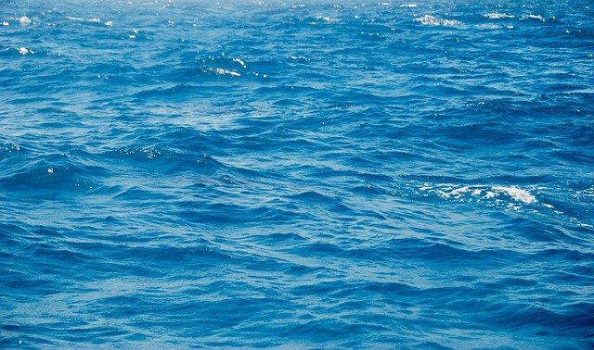


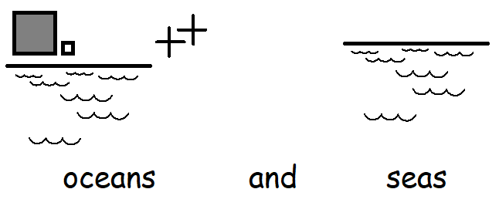

Slide 2

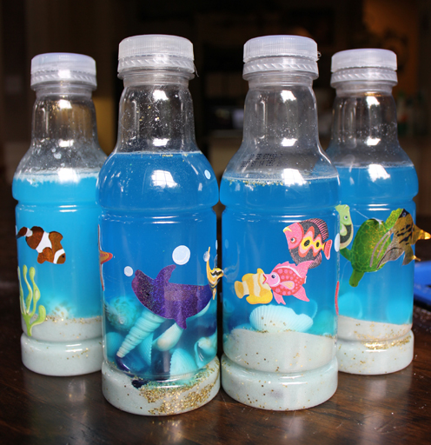
Ocean in a bottle
You will need:
An empty plastic bottle
Water
Blue food colouring
Baby oil
Sand or small stones (shells if you have some)
Strong glue
Plastic sea creatures (you could cut out your own from craft foam or a carrier bag)
Fill the bottle 1/3 with water
Add in some drops of food colouring until it is the shade of blue you would like.
Fill the rest of the bottle with baby oil.
Add in some sand, small stones or shells.
Drop in your sea creatures.
Replace the lid and glue it shut for a water tight seal.
Turn your bottle to make some waves.
Can you roll the bottle? Can you hear the waves and stones?

Slide 3

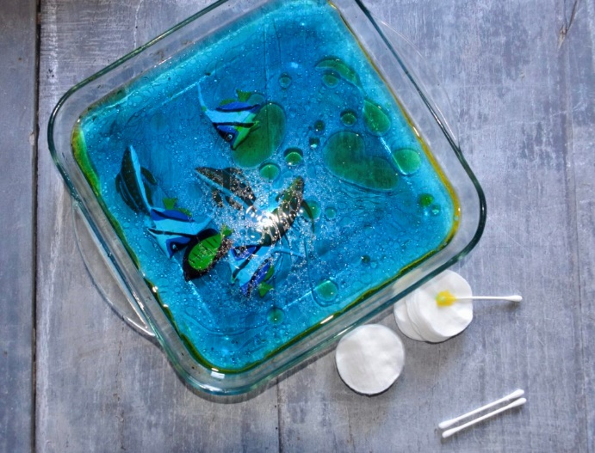
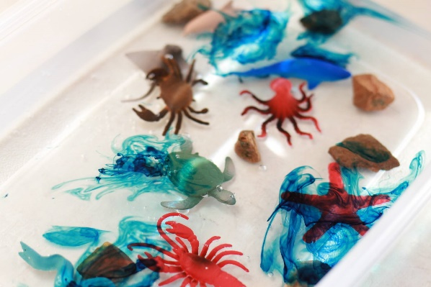
Oil Spillage clean up
You will need:
A tray or bowl
Water
Blue food colouring
sunflower or vegetable oil
Plastic objects that you don’t mind getting dirty!
Washing up liquid
Cleaning resources; Paper towels, a cloth, cotton wool, sponge, a brush, a spoon or ladle
Fill your tray half full with water and add a few drops of blue food colouring
Pour oil into the water, start with a small amount and add to it if you need to
Drop in your plastic objects
Explore the different cleaning resources and choose which one to try first
Use different methods with support to try and clean the objects in your oil spill – grasping, wiping, scrubbing, dipping, scooping. How does it feel?
Finally add in the washing up liquid – what happens? Can you splash the water to make bubbles? Is it easier to clean your objects from the oil spill?

Slide 4
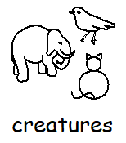
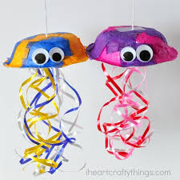
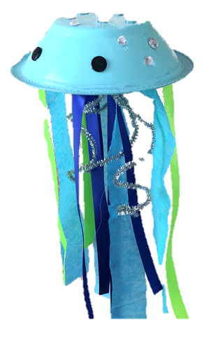
Jellyfish
https://www.youtube.com/watch?v=gdJjc6l6iII
You will need:
A paper plate, bowl or cup
A selection of materials such as ribbons, wool, fabric, strips cut from a carrier bag, strips of paper…whatever you can find!
Scissors
Tape or a hole punch
Feel the materials and choose which ones you would like to use
With support, cut strips that are about as long as your arm.
When you have cut enough strips attach them to your bowl, cup or plate either by making a hole and tying them on or using tape.
Hang your jellyfish somewhere where you can feel its tentacles on your body as you move.

