Slide 1



Learning from home
English
Class 12
All about me.
Finding out about my family.

Slide 2
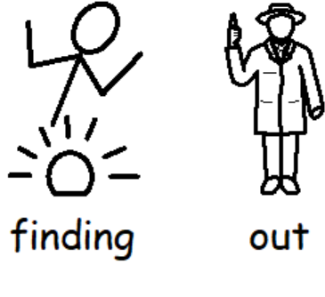
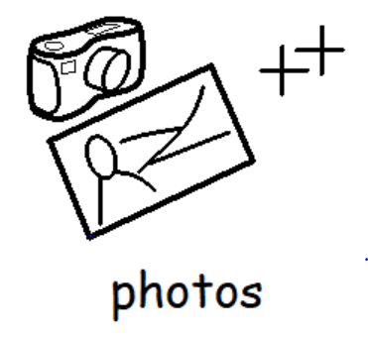
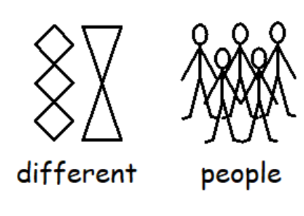
The students have been creating photo folders at school which show their exploration of the characters in Cinderella. They have been finding out about other people.

Slide 3
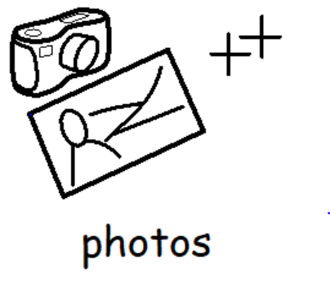

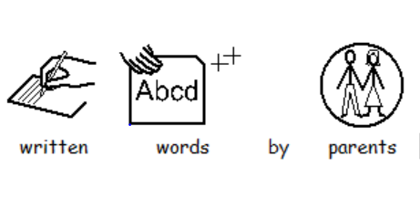
Your task at home….
Choose a family member at home to find out about.
Explore things related to that person. What makes them who they are?
Record or collect this information however you like…..

Slide 4
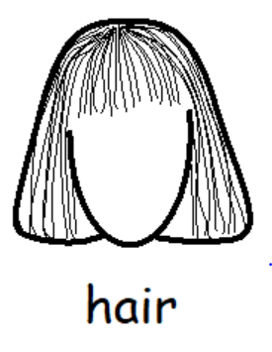

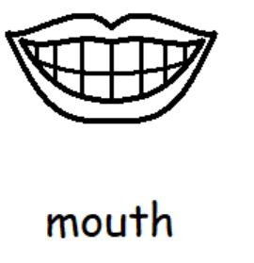
The focus is not about recording and creating a log as we know this will be parent supported.
The aim is to spend time taking part in the activities and talking about the things which make them who they are.
Below are some examples……
What does the person look like? (explore their face).
Colour hair? (feel and explore hair)
Colour eyes? (find their eyes)
Smile or make different expressions

Slide 5



Continued……
What is their name? How old are they? Where do they live, and with who? Have you got past photos you can look at and discuss?
Who is important to the this person?
What are their favourite past times and activities?
Favourite inside and outdoor activities?
(help to do these activities and get involved).

Slide 6


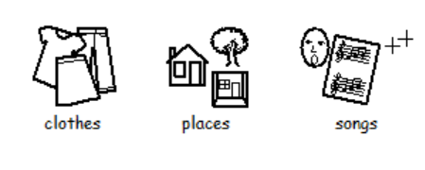
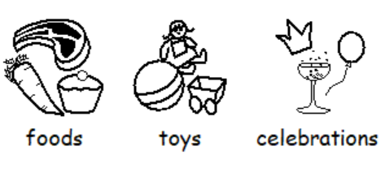

Continued……
What do they love doing?
What do they dislike?
What are their favourite clothes, places, songs, foods, toys, events, celebrations?
What are they good at?

