Slide 1
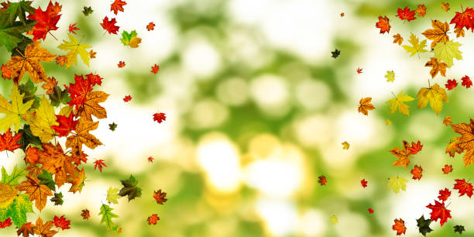

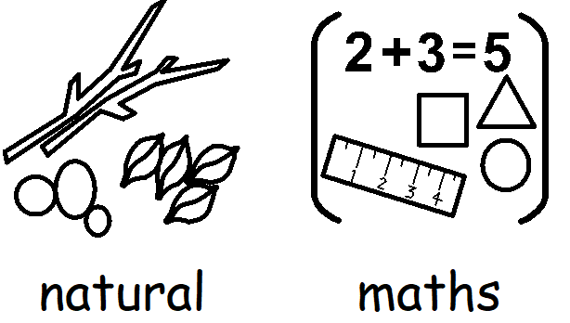

Slide 2
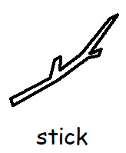
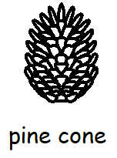
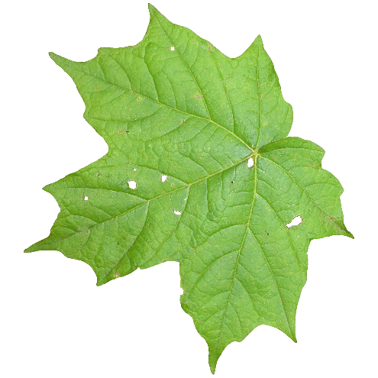
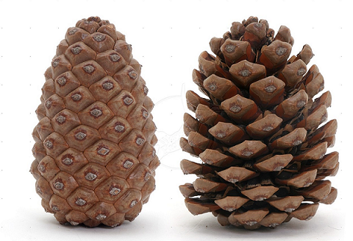
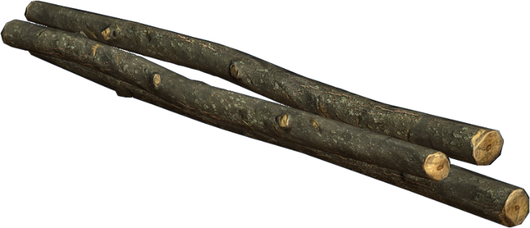
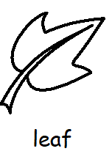
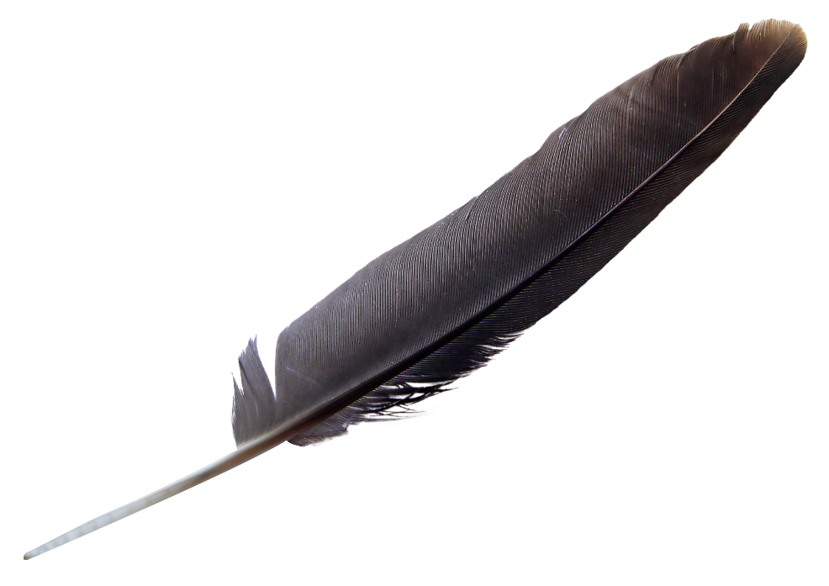
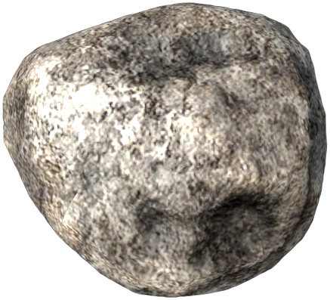
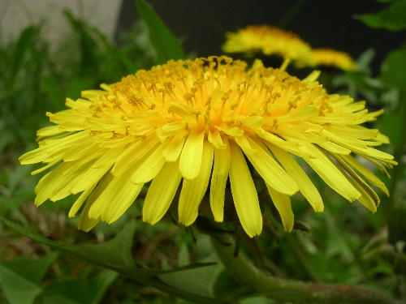
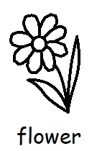
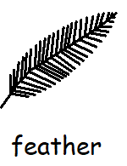
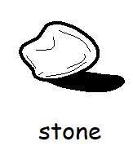
Here you will find some simple maths activities which can be done in your home, garden or on a walk using natural materials.
Why not start off with a nature scavenger hunt to see what you can find!

Slide 3
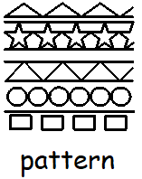
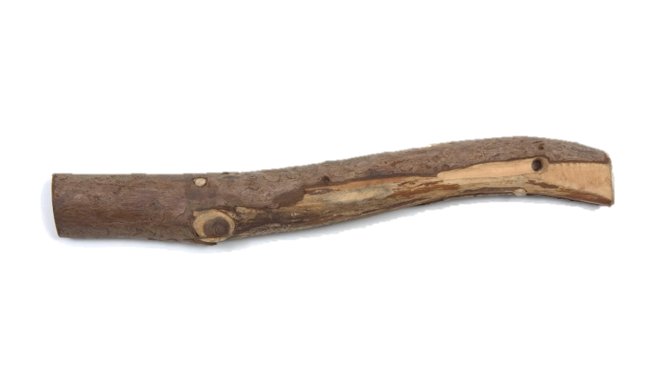
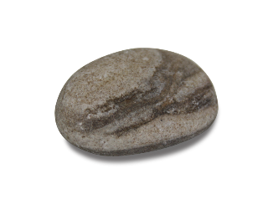


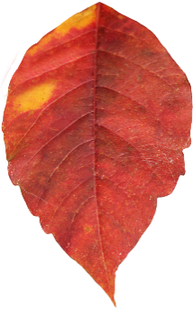

Pattern in nature
Can you make a repeating pattern using natural objects?
Make a pattern that is big and small
Make a pattern that is rough and smooth
Make a pattern using 2 different colours

Slide 4
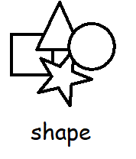
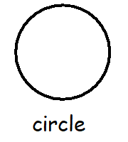
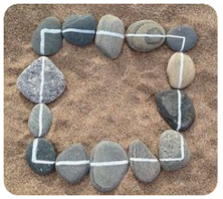
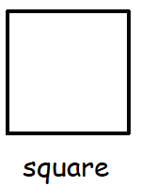
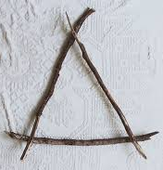
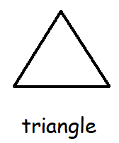
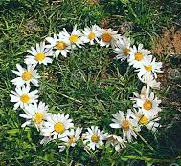
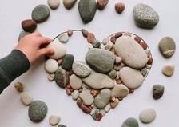
Shape in nature
Use the objects you have found to create different shapes.
Challenge: Can you fill a shape outline using your objects?
Can you make any other shapes?
Can you make a 3D shape?

Slide 5
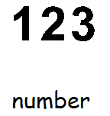
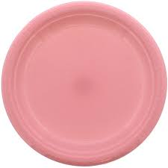
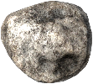
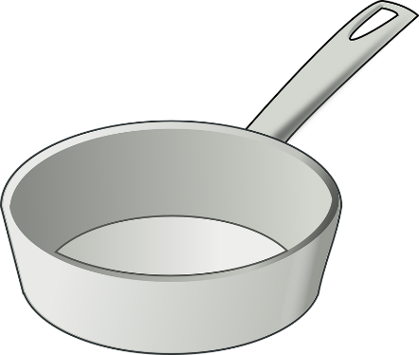
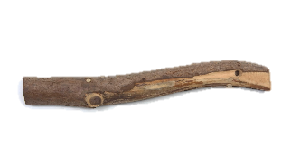
Number in nature
One and lots
Sorting & Counting
Using the same objects e.g. stone, put one stone into one bowl or pan and lots of stones into another.
Can you feel the difference between one and lots?
Can you hear the difference between one and lots when you shake the bowl?
Can you drop one into one bowl and lots into another?
Do lots smell different to just one?
Look at and/or feel the objects you have collected.
Can you find objects that are the same and sort them into different trays or bowls?
Which plates have more
and which have less?

Slide 6
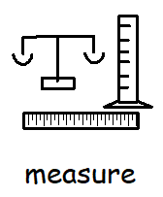
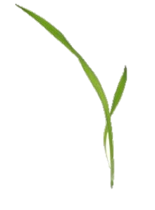
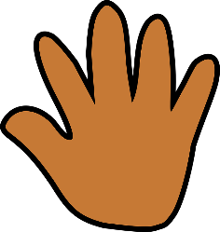


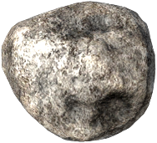
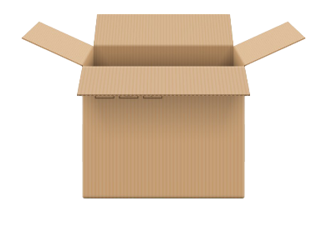
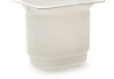
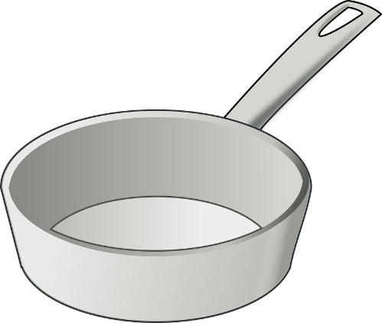



Measure in nature
Length
Weight
Capacity
Compare your objects by size.
You could measure them against a favourite toy, your finger or your hand.
Which are longer and which are shorter?
Can you put your objects in length order?
Feel the weight of your objects on your knee or the back of your hand. Are some heavy and harder to move? Can you lift some objects easier than others?
Grasp and release your objects into a metal tray or pan, do some make a louder noise?
Find different size containers. These could be empty boxes or pots from the recycling. See how many objects it takes to fill the different containers.
Are there some objects that won’t fit into your container?

