Slide 1


Eco
We have been learning about taking care of the environment. These activities give you ideas of how you can help you can help at home.

Slide 2



Lots of things use electricity.
Which of these objects can you see?

Slide 3
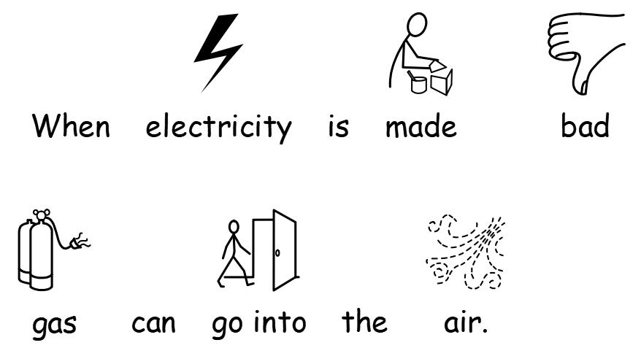


Slide 4
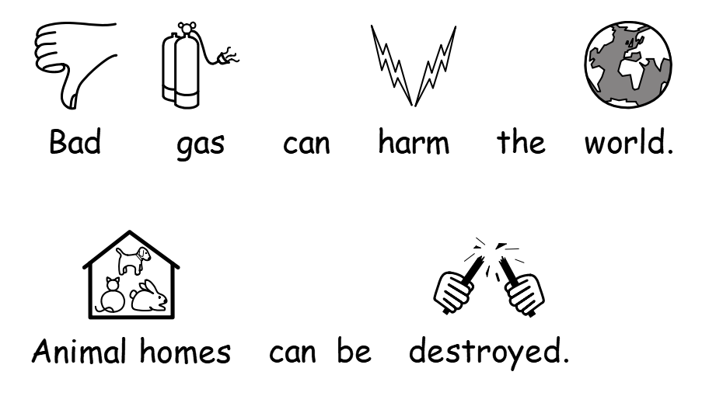
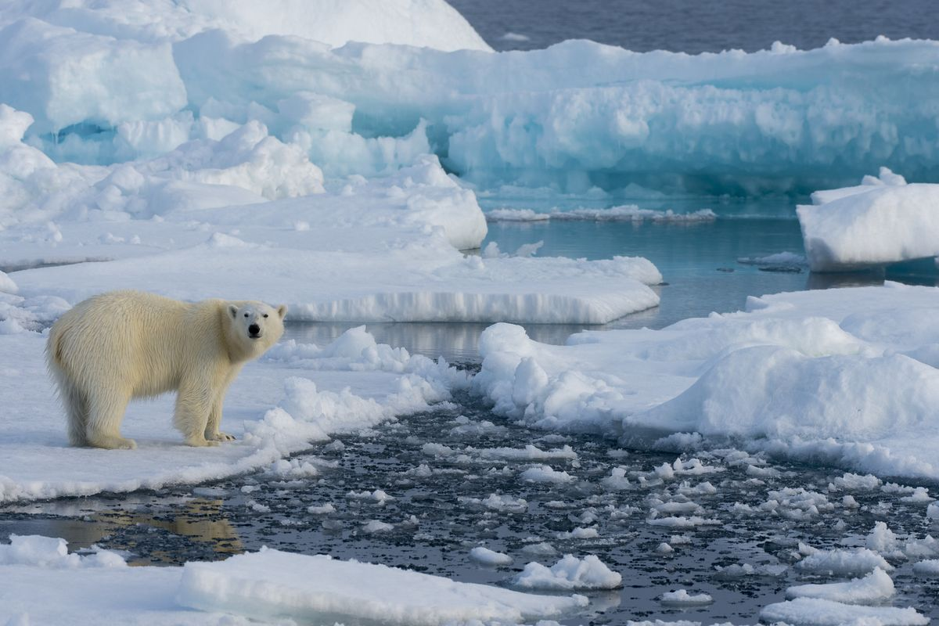

Slide 5


Slide 6
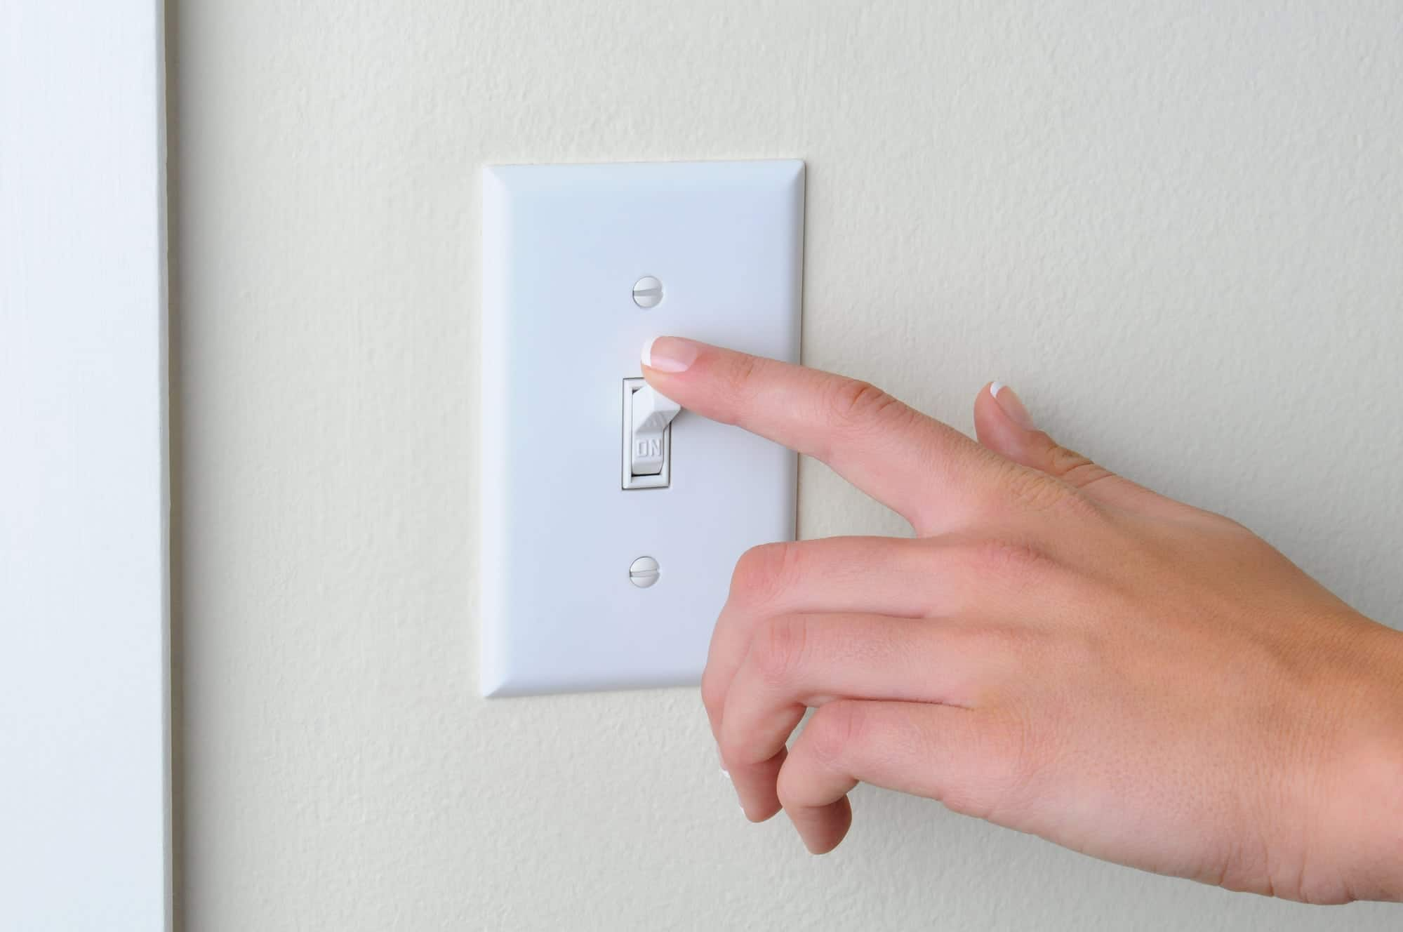

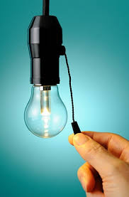
Switch off the lights when you leave the room.

Slide 7

Switch off the TV when you stop watching.

